Slide 1
Waterway-sunrise-i_656C

Slide 2
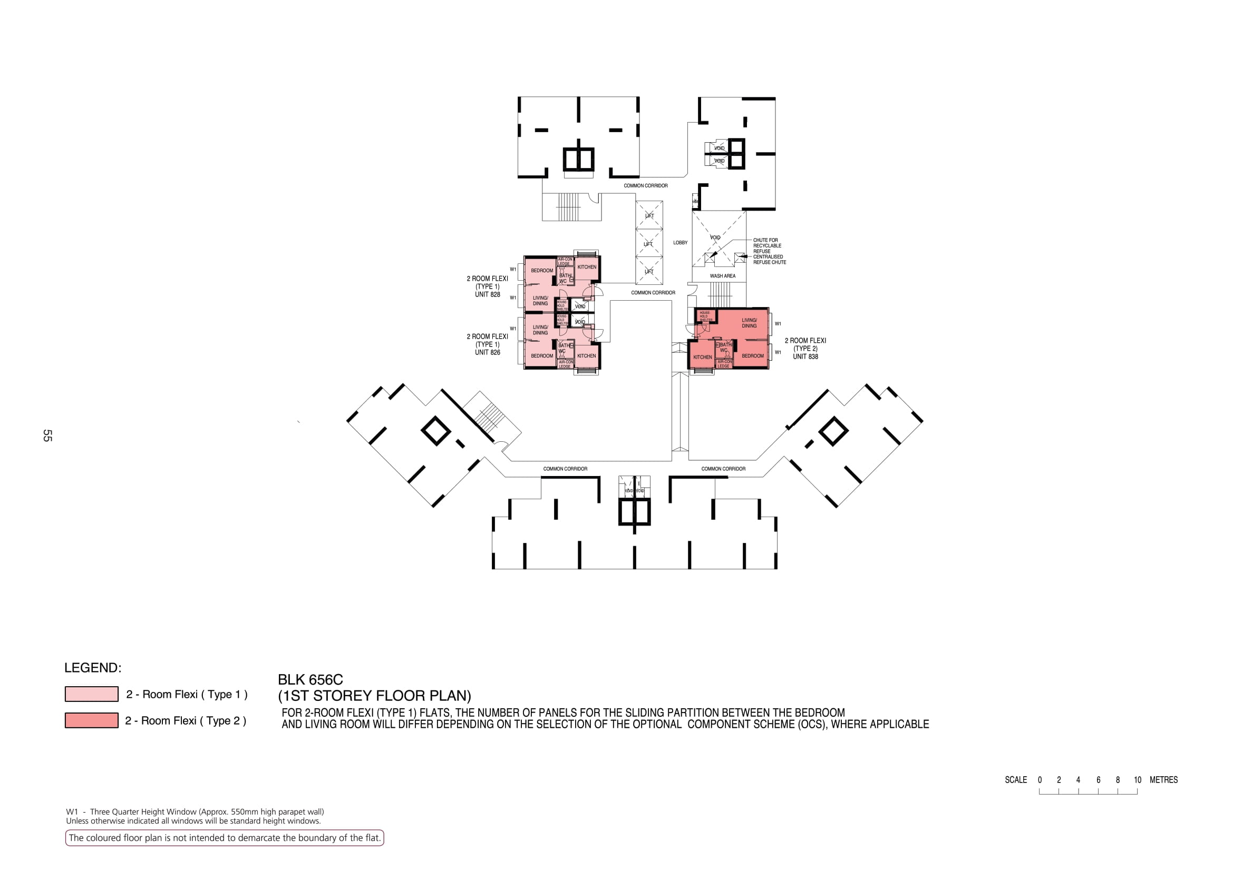

Slide 3
COMMON CORRIDOR
LOBBY
828
Wash area
COMMON CORRIDOR
826
838
COMMON CORRIDOR
COMMON CORRIDOR
COMMON CORRIDOR

Slide 4
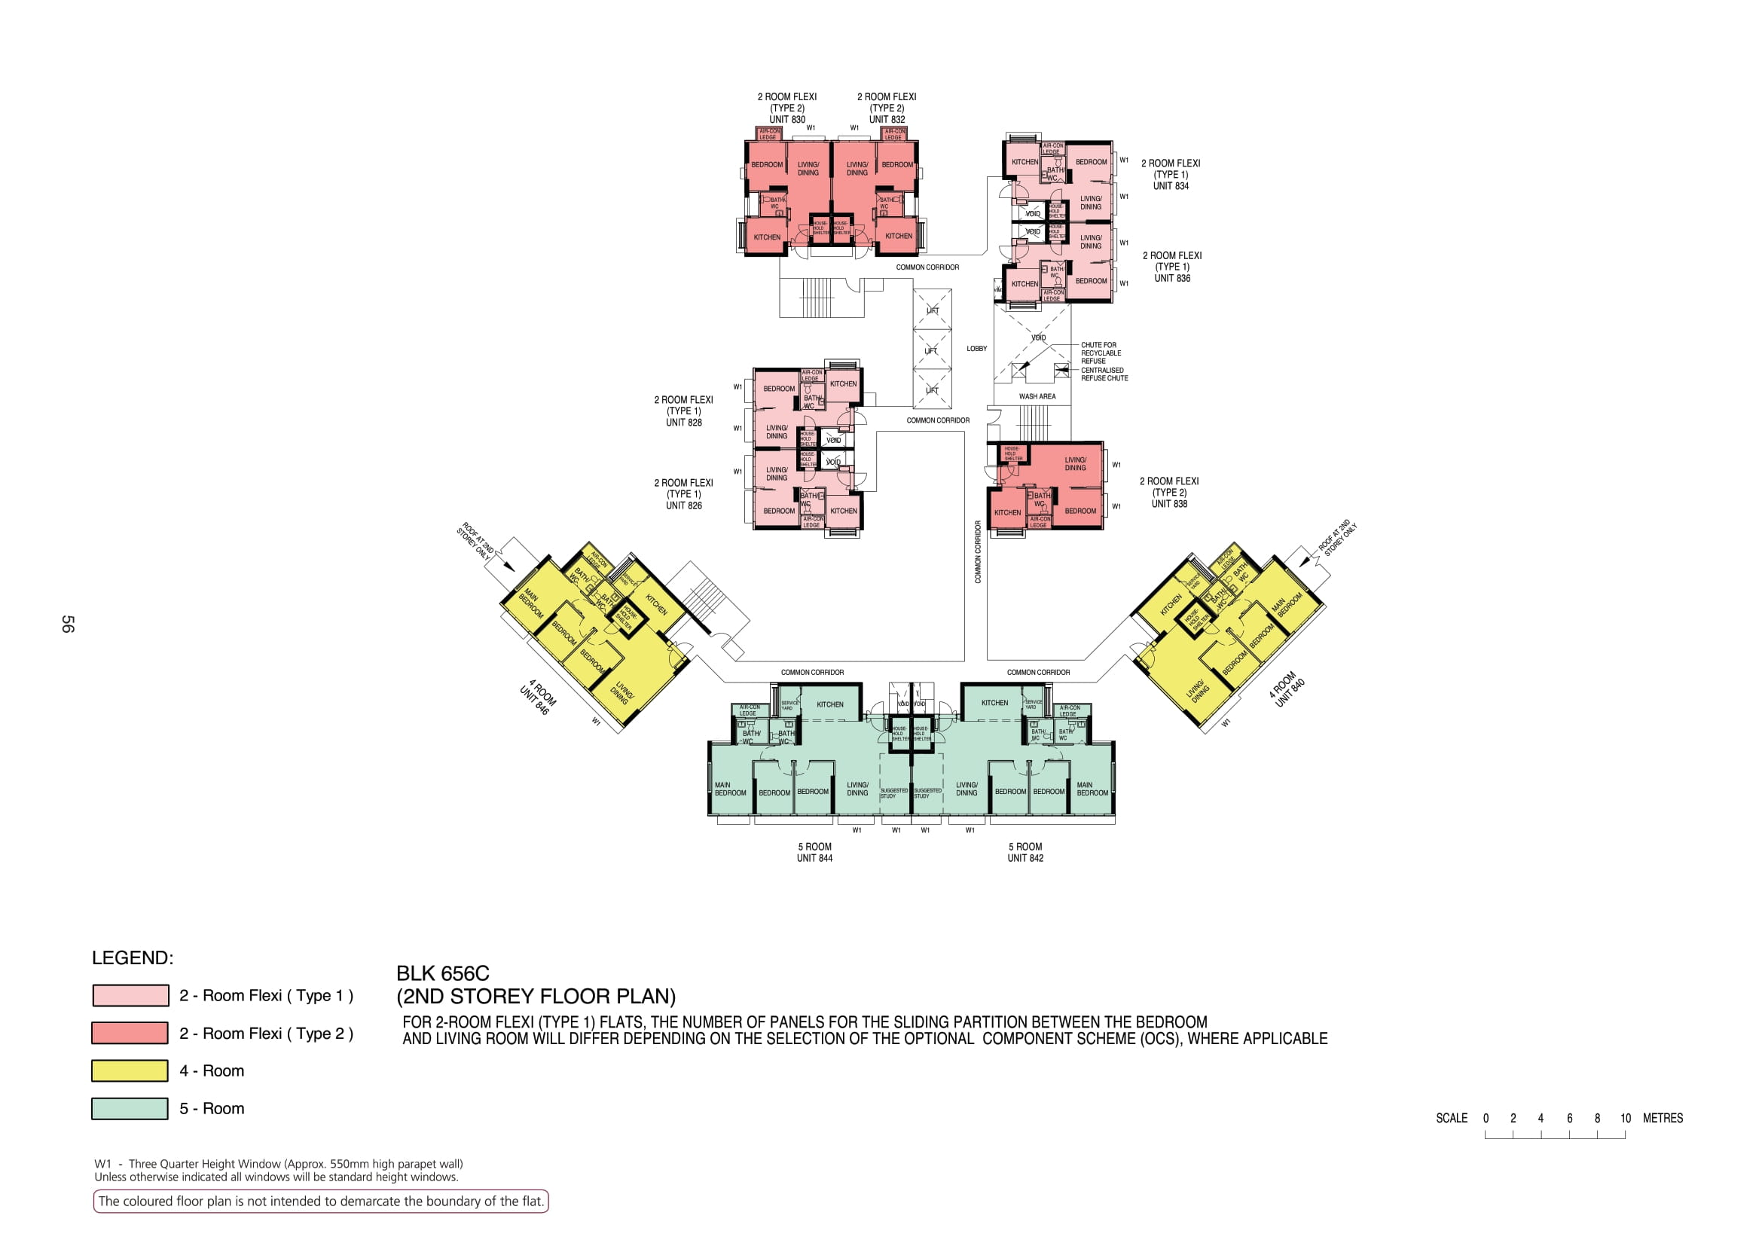

Slide 5
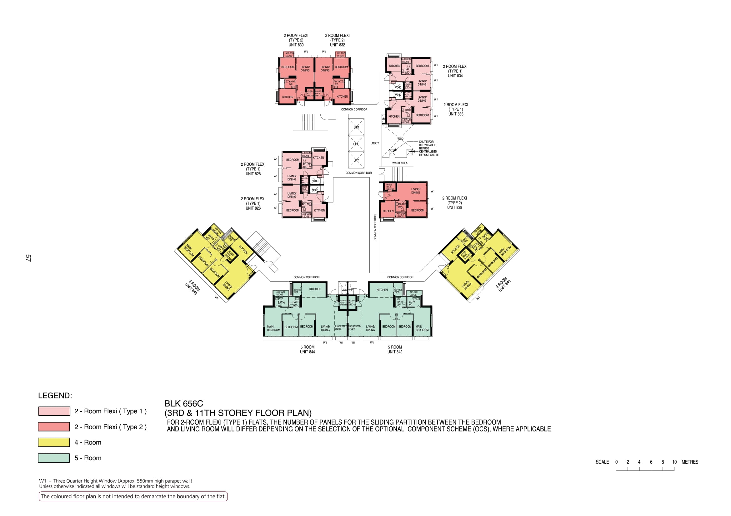

Slide 6
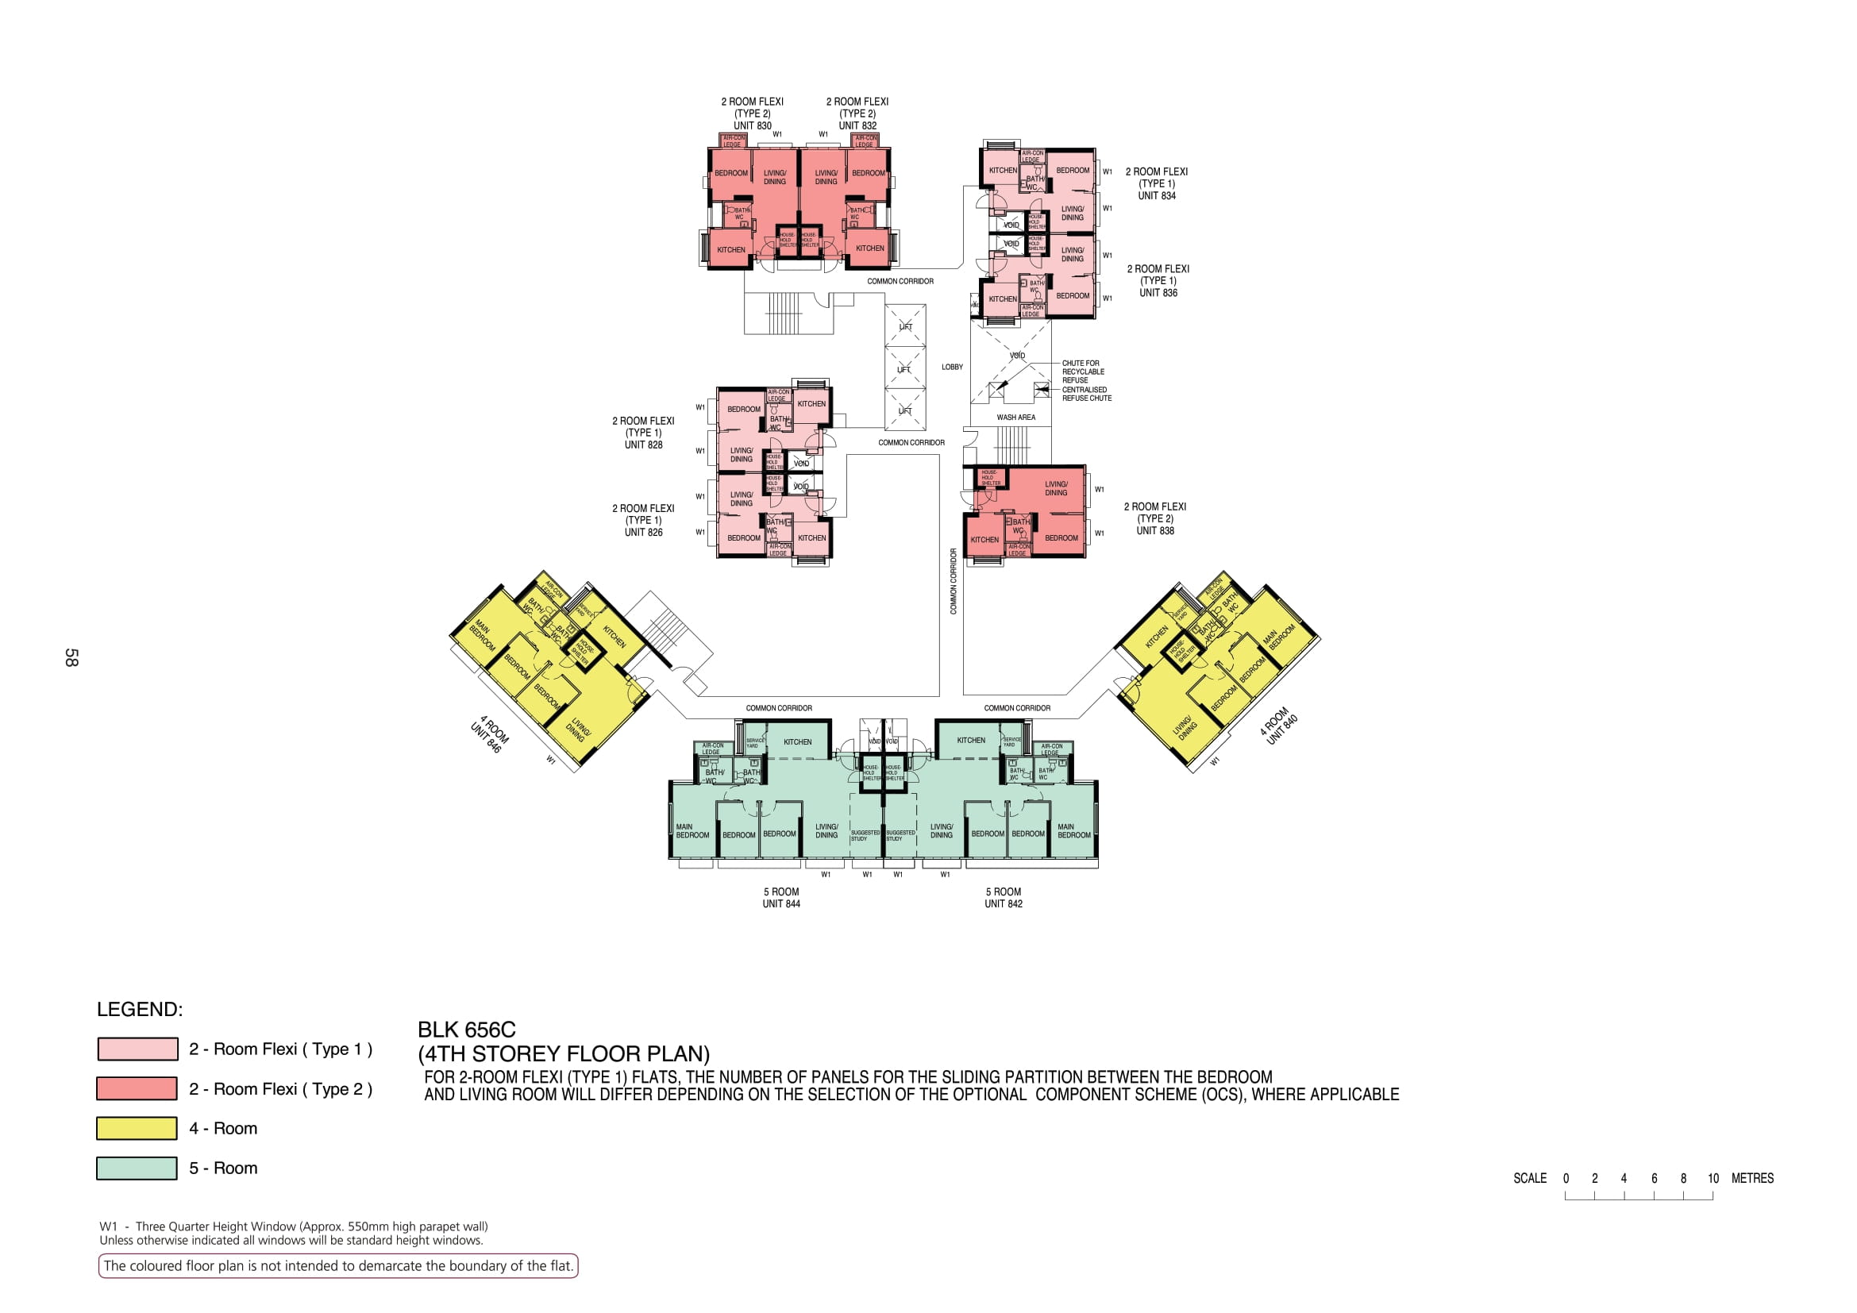

Slide 7
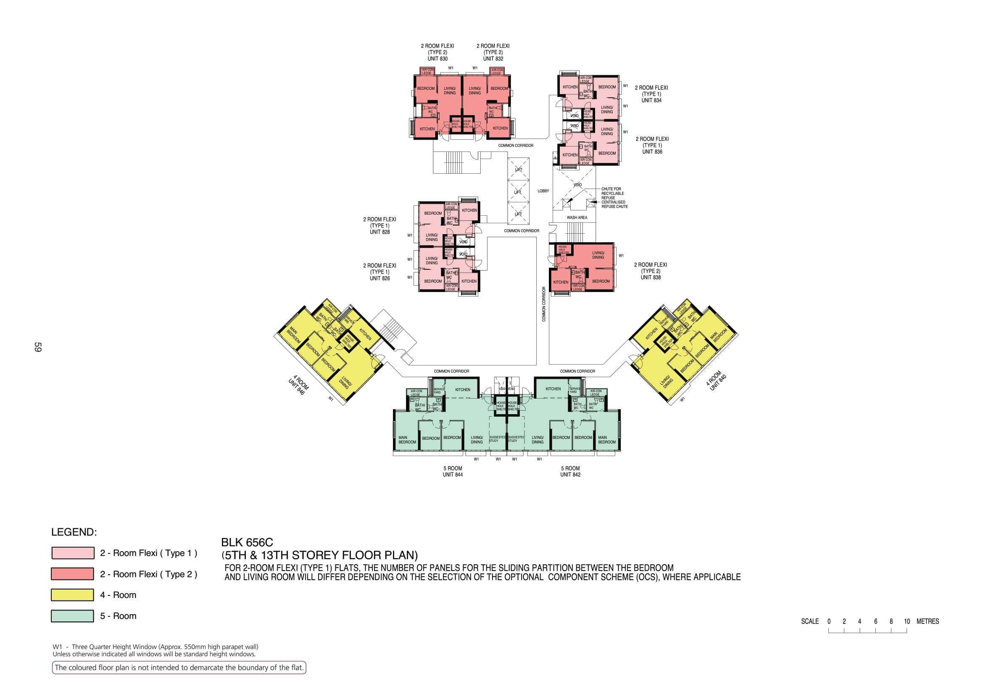

Slide 8


Slide 9
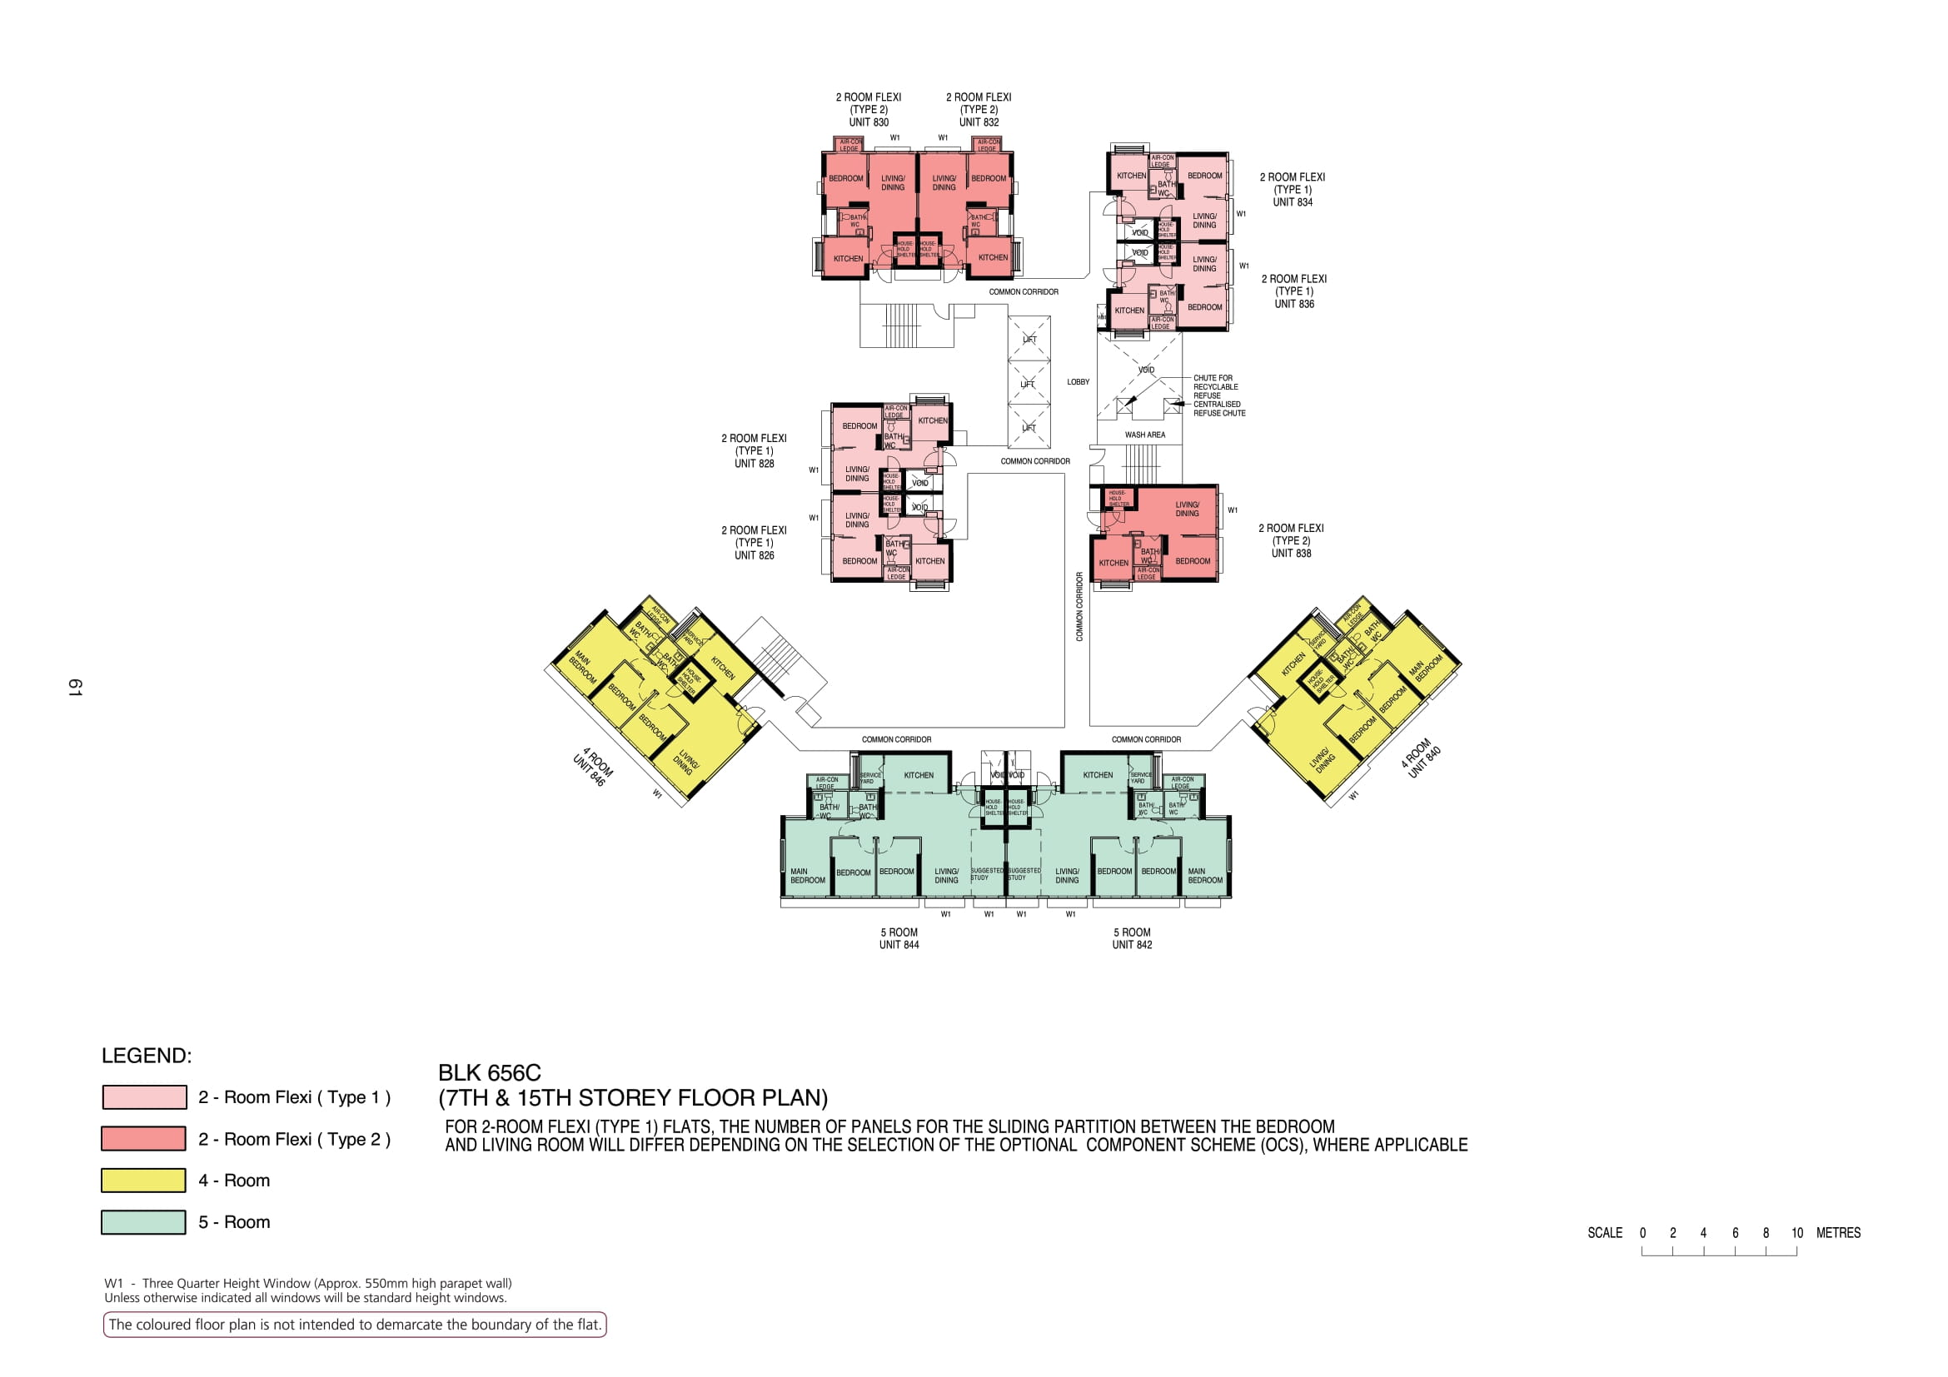

Slide 10
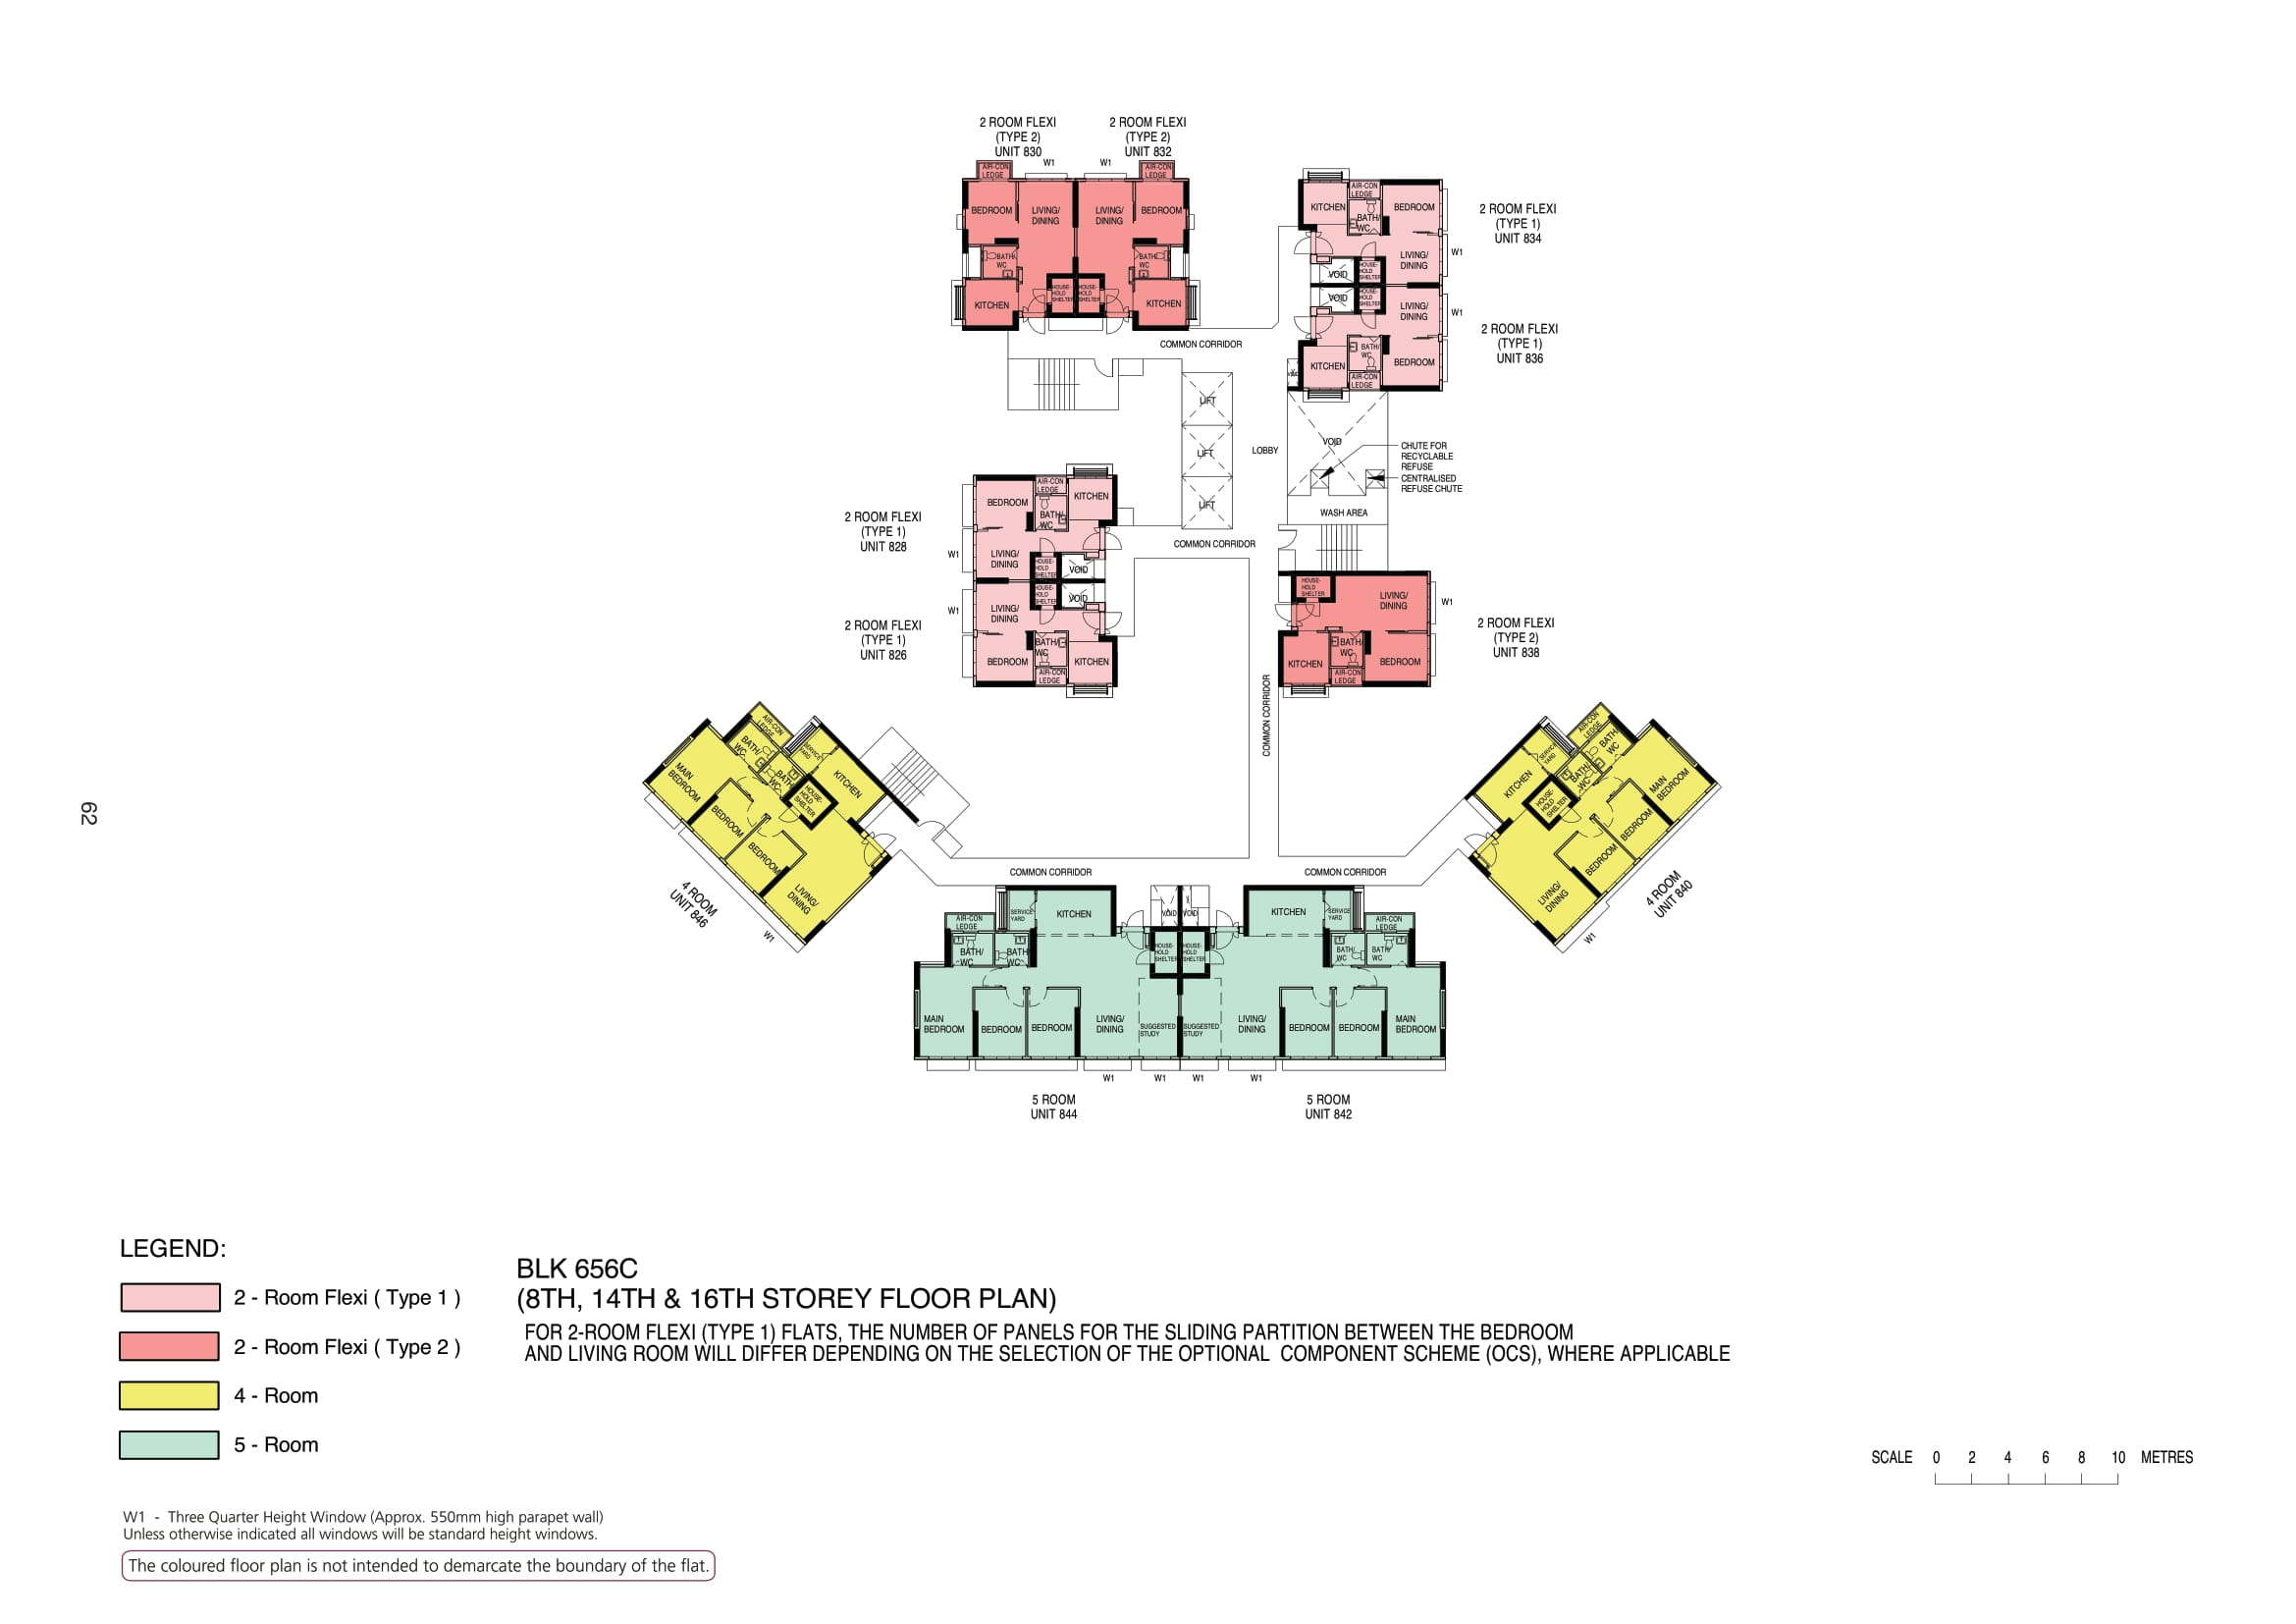

Slide 11
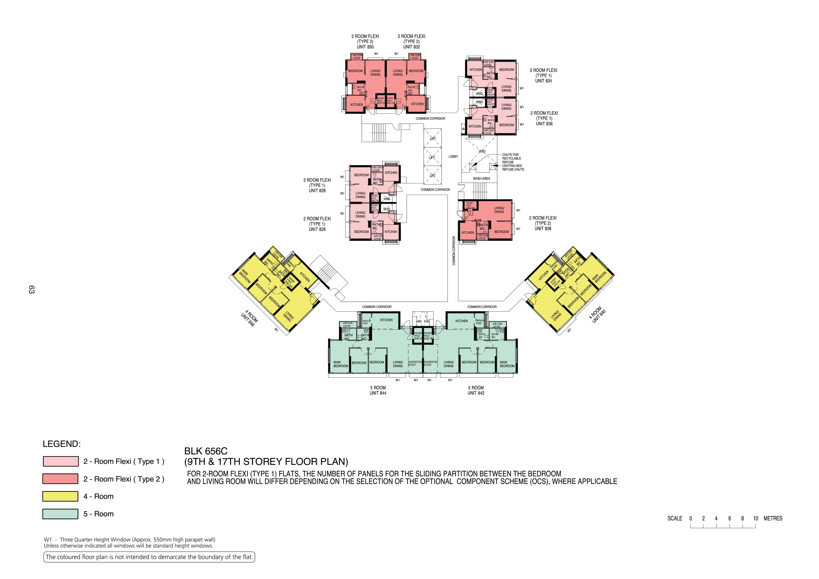

Slide 12
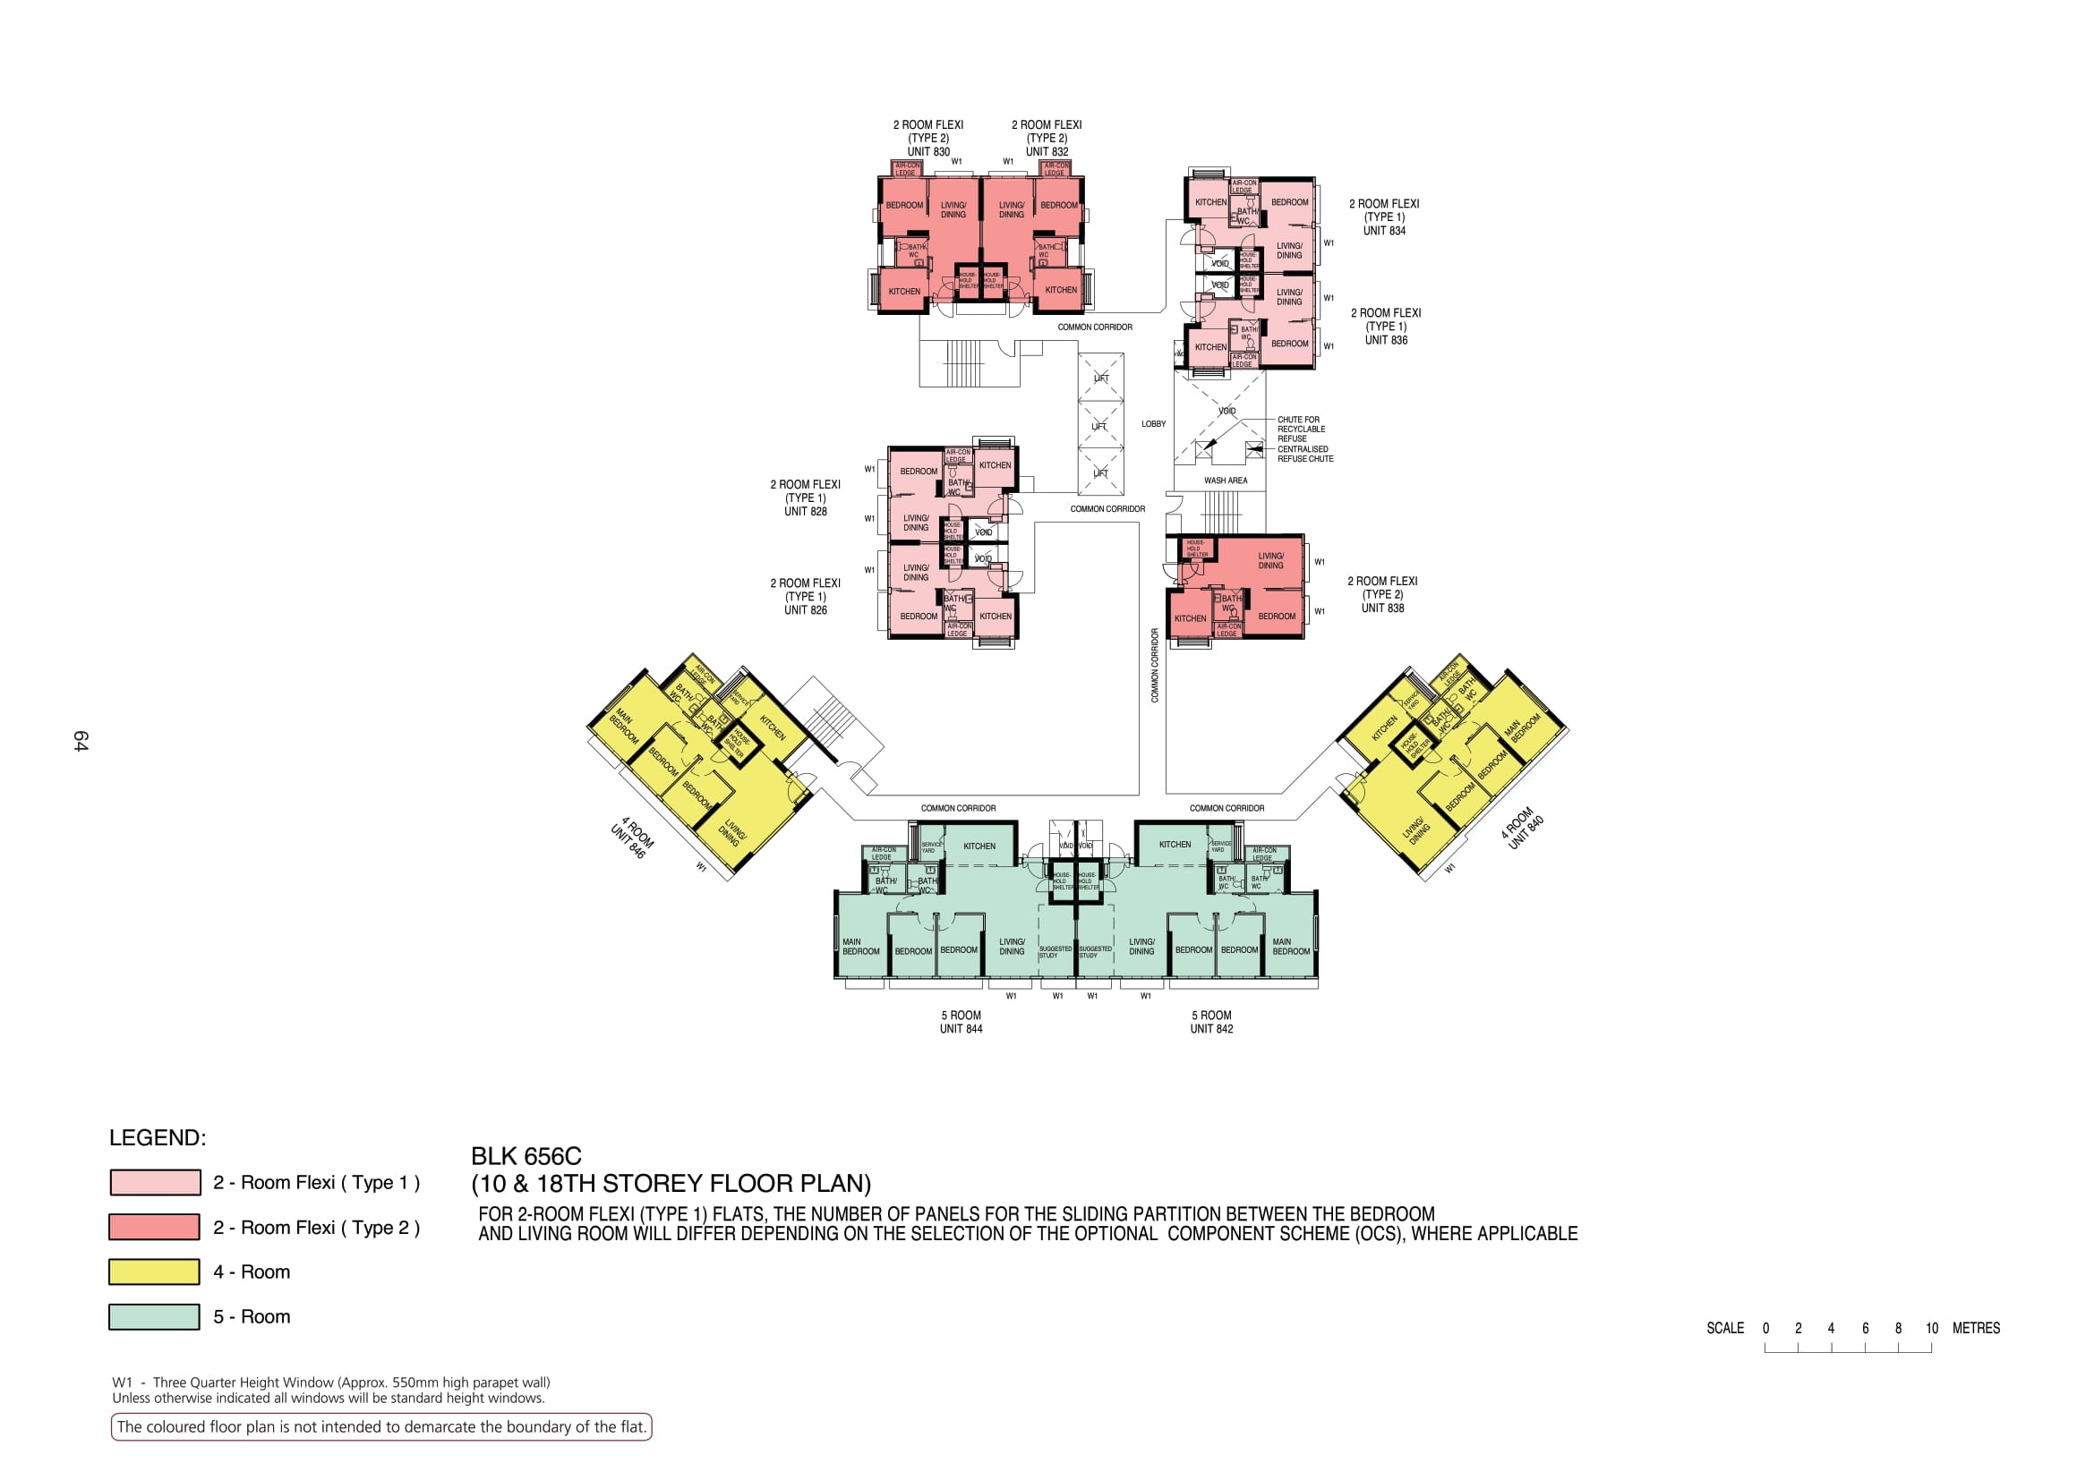

Slide 13
830
832
834
COMMON CORRIDOR
836
LOBBY
828
Wash area
COMMON CORRIDOR
826
838
COMMON CORRIDOR
846
840
COMMON CORRIDOR
COMMON CORRIDOR
844
842

